Slide 1
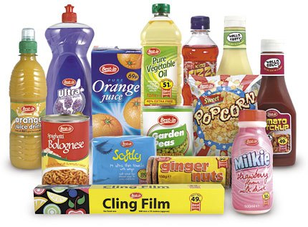
TOPIC 3: PRODUCT
https://www.marketing91.com/product-concept/

Slide 2
Product - the starting point of the Marketing Mix
Product
Price
Promotion
Place (Distribution)

Slide 3
What is a product?
Broad meaning
Good – A tangible, physical entity
Service – Intangible - result of the application of human and mechanical efforts to people or their possessions
Idea – A concept, philosophy, image, or issue
Most of the times, we will use the broad meaning.

Slide 4
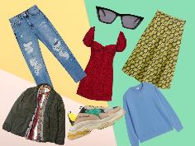

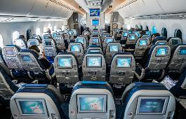
Goods-Services Continuum
Pure good
Pure service
https://www.independent.co.uk/extras/indybest/fashion-beauty/best-online-clothes-shops-uk-mens-vintage-womens-luxury-plus-size-discount-deals-a9155011.html
https://www.pocket-lint.com/phones/buyers-guides/120810-upcoming-smartphones-and-new-mobiles-coming-out-this-year
https://www.smartertravel.com/uploads/2017/06/long-haul-flight-airplane-cabin-1200x627.jpg

Slide 5
Types of products
Business
product
Consumer
product

Slide 6
Types of consumer products
Convenience
Product
A relatively inexpensive item that merits little shopping effort
Shopping
Product
A product that requires comparison shopping, because it is usually more expensive and found in fewer stores
Specialty
Product
A particular item for which consumers search extensively and are reluctant to accept substitutes
Unsought
Product
A product unknown to the potential buyer or a known product that the buyer does not really want at the point in time

Slide 7
Activity: Types of consumer products
The same product/service can be classified differently, depending on the consumer situation.
Watch the video and answer the following questions:
https://www.youtube.com/watch?v=i3S_nraulkQ
What type of consumer product is the luxury safari in the following cases:
Average South African consumer with a very low income?
Average fulltime German student?
German tourist who goes on holiday to South Africa every year?
Where on the product/service continuum would you place this offering?

Slide 8
Product Life Cycle
All goods pass through a product life cycle.
The PLC is a biological metaphor that traces the stages of a product’s acceptance, from its introduction (birth) to its decline (death).
Follow the link, and answer the questions.
https://www.youtube.com/watch?v=e-P1RMTOedE
Identify the stages in the typical simplified product life cycle (PLC).
Explain the impact each stage of the PLC has on the business.

Slide 9
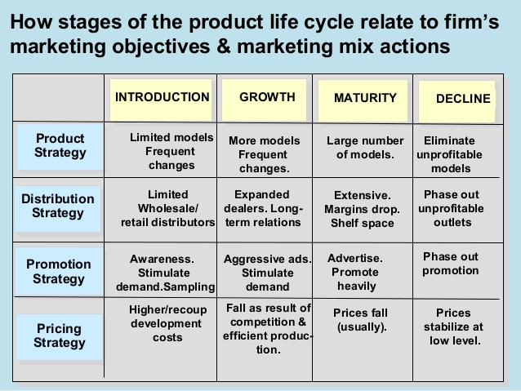
https://image.slidesharecdn.com/dr-161220041446/95/channel-design-product-lifecycle-marketing-strategy-drrajminlung-15-638.jpg?cb=1482207766

Slide 10
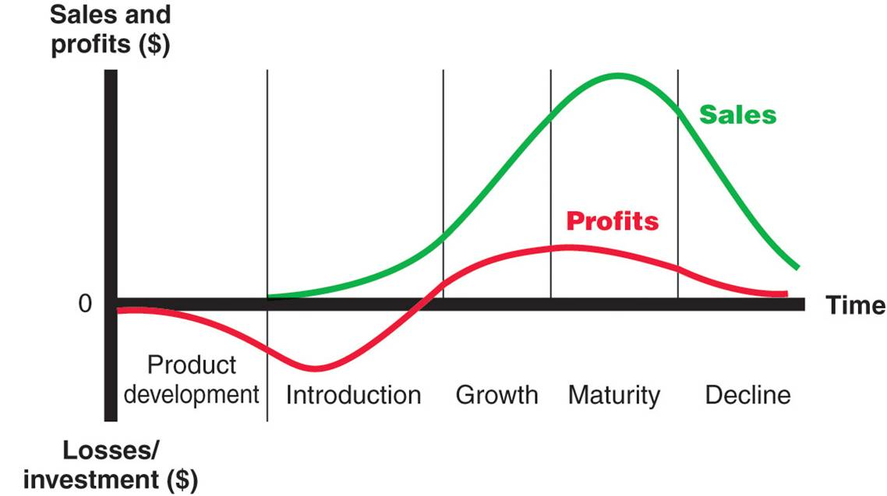
Illustration of a PLC (stages, sales and profit curves)
https://marketing-insider.eu/wp-content/uploads/2015/06/Product-Life-Cycle-Stages.jpg

Slide 11
Activity: Product life cycle
This video shows products that were in different stages of the PLC 5 years ago. Follow the link, and answer the question.
Identify the current stage (2022) of the PLC for each of the products in the video.
Why did you put it in this stage?
https://www.youtube.com/watch?v=oma7q4sQW54

Slide 12
New product development
New products:
are needed to replace those that reached decline.
result when changes are made to existing products to prolong the life of the product or to better compete with similar products.

Slide 13
Categories of new products
New-to-the-world products (really new products)
Really new products – inventions that create a whole new market. Examples?
New-to-the-firm products (new product lines)
Products are not new to the world, but are new to the firm. Companies develop these products to enter an already established market for the first time. Often these products are similar to competitors’ products already available in the market but with some level of difference. Examples?
Additions to existing product lines
A product line extension is when an existing brand launches new products in a product category where they already offer products. Examples?

Slide 14
Categories of new products
Improvements/additions to existing products
Current products made better or changed slightly. Often advertised as “New & improved”.
Repositioning
Occurs when new applications or uses are promoted for existing products, e.g. baking soda (Backsoda) repositioned as a refrigerator deodorant; aspirin used for headaches, now repositioned as a safeguard against heart attacks.
Cost reductions
Existing products that offer similar benefits at a lower cost.

Slide 15
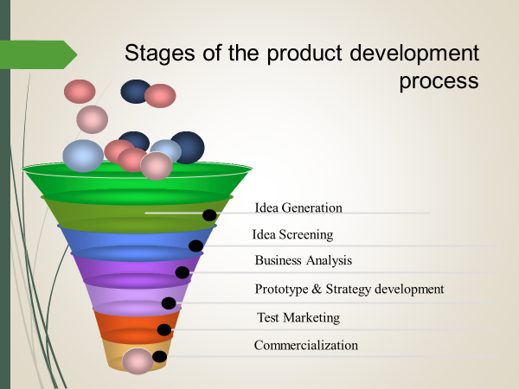
Stages in the new product development process

Slide 16
1. Idea generation
Sources for idea generation
Company – R & D staff, sales staff, anyone, e.g. 14% of IBM new ideas from R&D, 41% from employees, 36% from customers
Customers – best source of ideas
Other sources - advertising agencies or market research organizations
Non-direct sources – improvements in brakes of car – racing drivers, airplanes

Slide 17
2. Idea screening & concept testing
The first filter in the product development process, which eliminates ideas that are inconsistent with the organization’s new product strategy, objectives or resources.
Seeking a sample of potential buyers’ responses to a product idea.
Many product ideas are scrapped during this stage.

Slide 18
3. Business analysis
Considerations in Business Analysis Stage
Demand
Cost
Sales
Profitability
Notes:
Notes:
In the business analysis stage, the preliminary figures for demand, cost, sales, and profitability are calculated.
In an existing product, the accuracy of revenue projections can be made using industry estimates of total market size. However, forecasting market share for a new entry is a bigger challenge.
These questions are asked during the business analysis stage:
* What is the likely demand for the product?
* What impact would the new product have on total sales, profits, market share, and return on investment?
* How would the introduction of a new product affect existing products?
* Would the new product cannibalize existing products? * Would current customers benefit from the product? * Would the product enhance the image of the company’s overall product mix? * Would the new product affect current employees, such as hiring more people or reducing the size of the workforce? * What new facilities would be needed? * How might competitors respond? * What is the risk of failure? Is the company willing to take the risk?
4. The business analysis is important because costs increase dramatically once a product idea enters the development stage.

Slide 19
4. Development of prototype and strategies
To test acceptability, the idea is converted into a prototype or working model
The prototype is tested for overall functioning both in the lab and in the field
Crucial questions during this phase include how much quality to build into the product
This phase is lengthy and expensive so a small number of product ideas are put into development

Slide 20
5. Test marketing
Final stage of product development per se
Ranges from reliability tests to mini-launches
(The limited introduction of a product and a marketing program to determine the reactions of potential customers in a market situation)
Undertaken to avoid high rate of product failure
Hassloch, Germany - https://en.wikipedia.org/wiki/Ha%C3%9Floch

Slide 21
6. Commercialization
Making product available in the market
Fully developed marketing mix

Slide 22
Designing a marketing mix for new products
Determining the Marketing Mix for New Products - YouTube

Slide 23
Product failure
67% to 95% of all new products fail.
Reasons for product failure
The market does not “need” offering.
Overestimated market size.
Incorrectly positioned product.
Ineffective promotion, including packaging message, which may have used misleading or confusing marketing message about the product, its features, or its use.
Not understanding the target market segment.

Slide 24
Product failure
Incorrectly priced—too high and too low.
Excessive research and/or product development costs.
Underestimating or not correctly understanding competitive activity or retaliatory response.
Poor timing of market entry.
Wrong distribution channels.

Slide 25
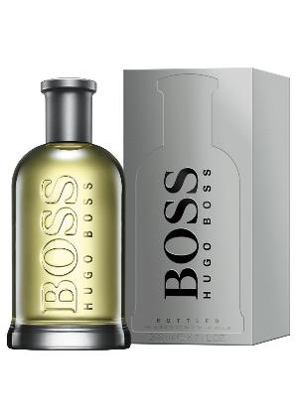
Elements of a product
A product consists of various elements. Two important ones are:
Brand (name, logo, slogan)
Packaging & label
https://i1.adis.ws/i/truworths/prod1490786_1?w=2020&h=2832&img404=404&v=1

Slide 26
Branding: Elements of a brand
Name, term, symbol, design, logo, slogan or combination thereof that identifies a seller’s products and differentiates them from competitors’ products.
Brand name/term:
Symbol/design/logo:
Slogan:
https://akm-img-a-in.tosshub.com/indiatoday/images/story/201707/nike-647_071117061035.jpg?size=770:433

Slide 27



What is a good brand name?
The name should be easy for customers to say,
spell and remember.
The name should indicate the product’s major benefits
and suggest a product’s uses and special characteristics.
The brand name should be unique.
Do these brands fulfil the requirements of a good brand name?
https://carfromjapan.com/article/industry-knowledge/meaning-of-hyundai-logo-revealed/
https://www.google.com/imgres?imgurl=https%3A%2F%2Fcdn.worldvectorlogo.com%2Flogos%2Fnational-1.svg&imgrefurl=https%3A%2F%2Fworldvectorlogo.com%2Flogo%2Fnational-1&tbnid=X2kNrSEoGltotM&vet=12ahUKEwikz6Or9_fsAhXr2OAKHff4DZIQMyhSegQIARB1..i&docid=bwWuUR300O4NTM&w=2500&h=2500&q=national%20logo%20images%20free&ved=2ahUKEwikz6Or9_fsAhXr2OAKHff4DZIQMyhSegQIARB1
https://www.google.com/imgres?imgurl=http%3A%2F%2Fpngimg.com%2Fuploads%2Fapple_logo%2Fapple_logo_PNG19678.png&imgrefurl=http%3A%2F%2Fpngimg.com%2Fimgs%2Flogos%2Fapple_logo%2F&tbnid=081QjPDwXUQv9M&vet=12ahUKEwjWosHW9vfsAhWs2-AKHRiUA1cQMygMegUIARDCAQ..i&docid=GyrBUuhaBVs2eM&w=2000&h=2200&q=apple%20logo%20images%20free&ved=2ahUKEwjWosHW9vfsAhWs2-AKHRiUA1cQMygMegUIARDCAQ

Slide 28
How to come up with a brand name for a product/business
(215) How to Name Your Business (Step-By-Step) - YouTube

Slide 29
Mistakes with brand names in international markets
When you're globalizing a brand, it's always a good idea to check whether your name, logo, or tag line means something different in the regions where you're expanding. Here are some of the worst examples that neglected this crucial marketing step.

Slide 30
Activity: Benefits of branding
Watch the video and make a list of the:
Benefits of branding for the consumer
Benefits of branding for the marketer
https://www.youtube.com/watch?v=dBGhcyLBmLQ&list=PLuAz-nxZVHKA--O4s52UC9Cx5n7cXtdy4

Slide 31
Brand names that became product names
Brand It: Common Brand Names That Are Household Words (stickybranding.com)

Slide 32
Packaging
Packaging is a subset of marketing where a brand designs and develops the wrapper or container to aid its transport, handling, delivery, and communicate the brand and product information by making it look attractive.
Kinds or methods of packaging will depend largely upon the nature of the contents in terms of their value, physical composition, and durability.
Type of packaging also depends on the length of the distribution channel, the amount of handling which the container will receive, and variations in climatic conditions which may be encountered between the point of manufacture and sales are also to be taken into account.

Slide 33
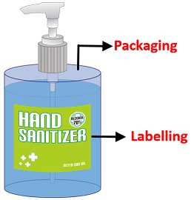
Labels as part of packaging
Labels are applied to packaging to indicate the contents, product specifications, contact details, health and safety warnings and guidelines for use, and any additional marketing, branding, or pricing information that applies to a product.
Brand names, tag lines, designs, symbols and images printed on the product boxes and wrappers etc. are all part of the labeling.

Slide 34
Three levels of packaging: Primary, secondary & transportation packaging
Primary packaging:
packaging which is in direct contact with the product, as it carries the product and remains with the product until it is consumed, e.g. curvy shaped bottle of Coca Cola, tube “holding” the toothpaste.
Secondary packaging:
additional layer of packaging provided to the product so as to avoid breakage, or to protect it from external damage, box in which you find the tube of toothpaste.
Transportation packaging:
third layer of packaging, commonly used when the goods are transported from one location to another. Provides protection, from any damage, spoilage or breakage, & makes it convenient to transport the items in bulk.

Slide 35
Factors to take into account when deciding on your product packaging
Packaging Psychology by Nick Kolenda

Slide 36
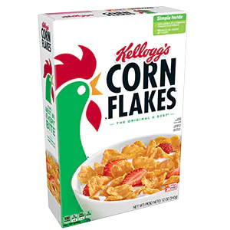
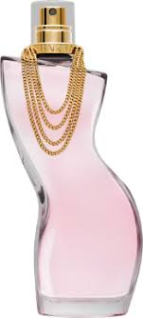
Functions of packaging
Helps promote the product- Word “Kellogg’s” printed on box of cereal (box is secondary, plastic bag is primary packaging)
Makes product more appealing to consumer, e.g. perfume bottle
Box helps to more easily ship and pack the cereal than would have been the case without any packaging
https://www.kelloggs.com/en_US/products/kellogg-s-corn-flakes-cereal-product.html
https://encrypted-tbn0.gstatic.com/images?q=tbn:ANd9GcT91B9XVmH8drGfJtsEZ8aUyjxsCs9_nKIb4w&usqp=CAU

Slide 37
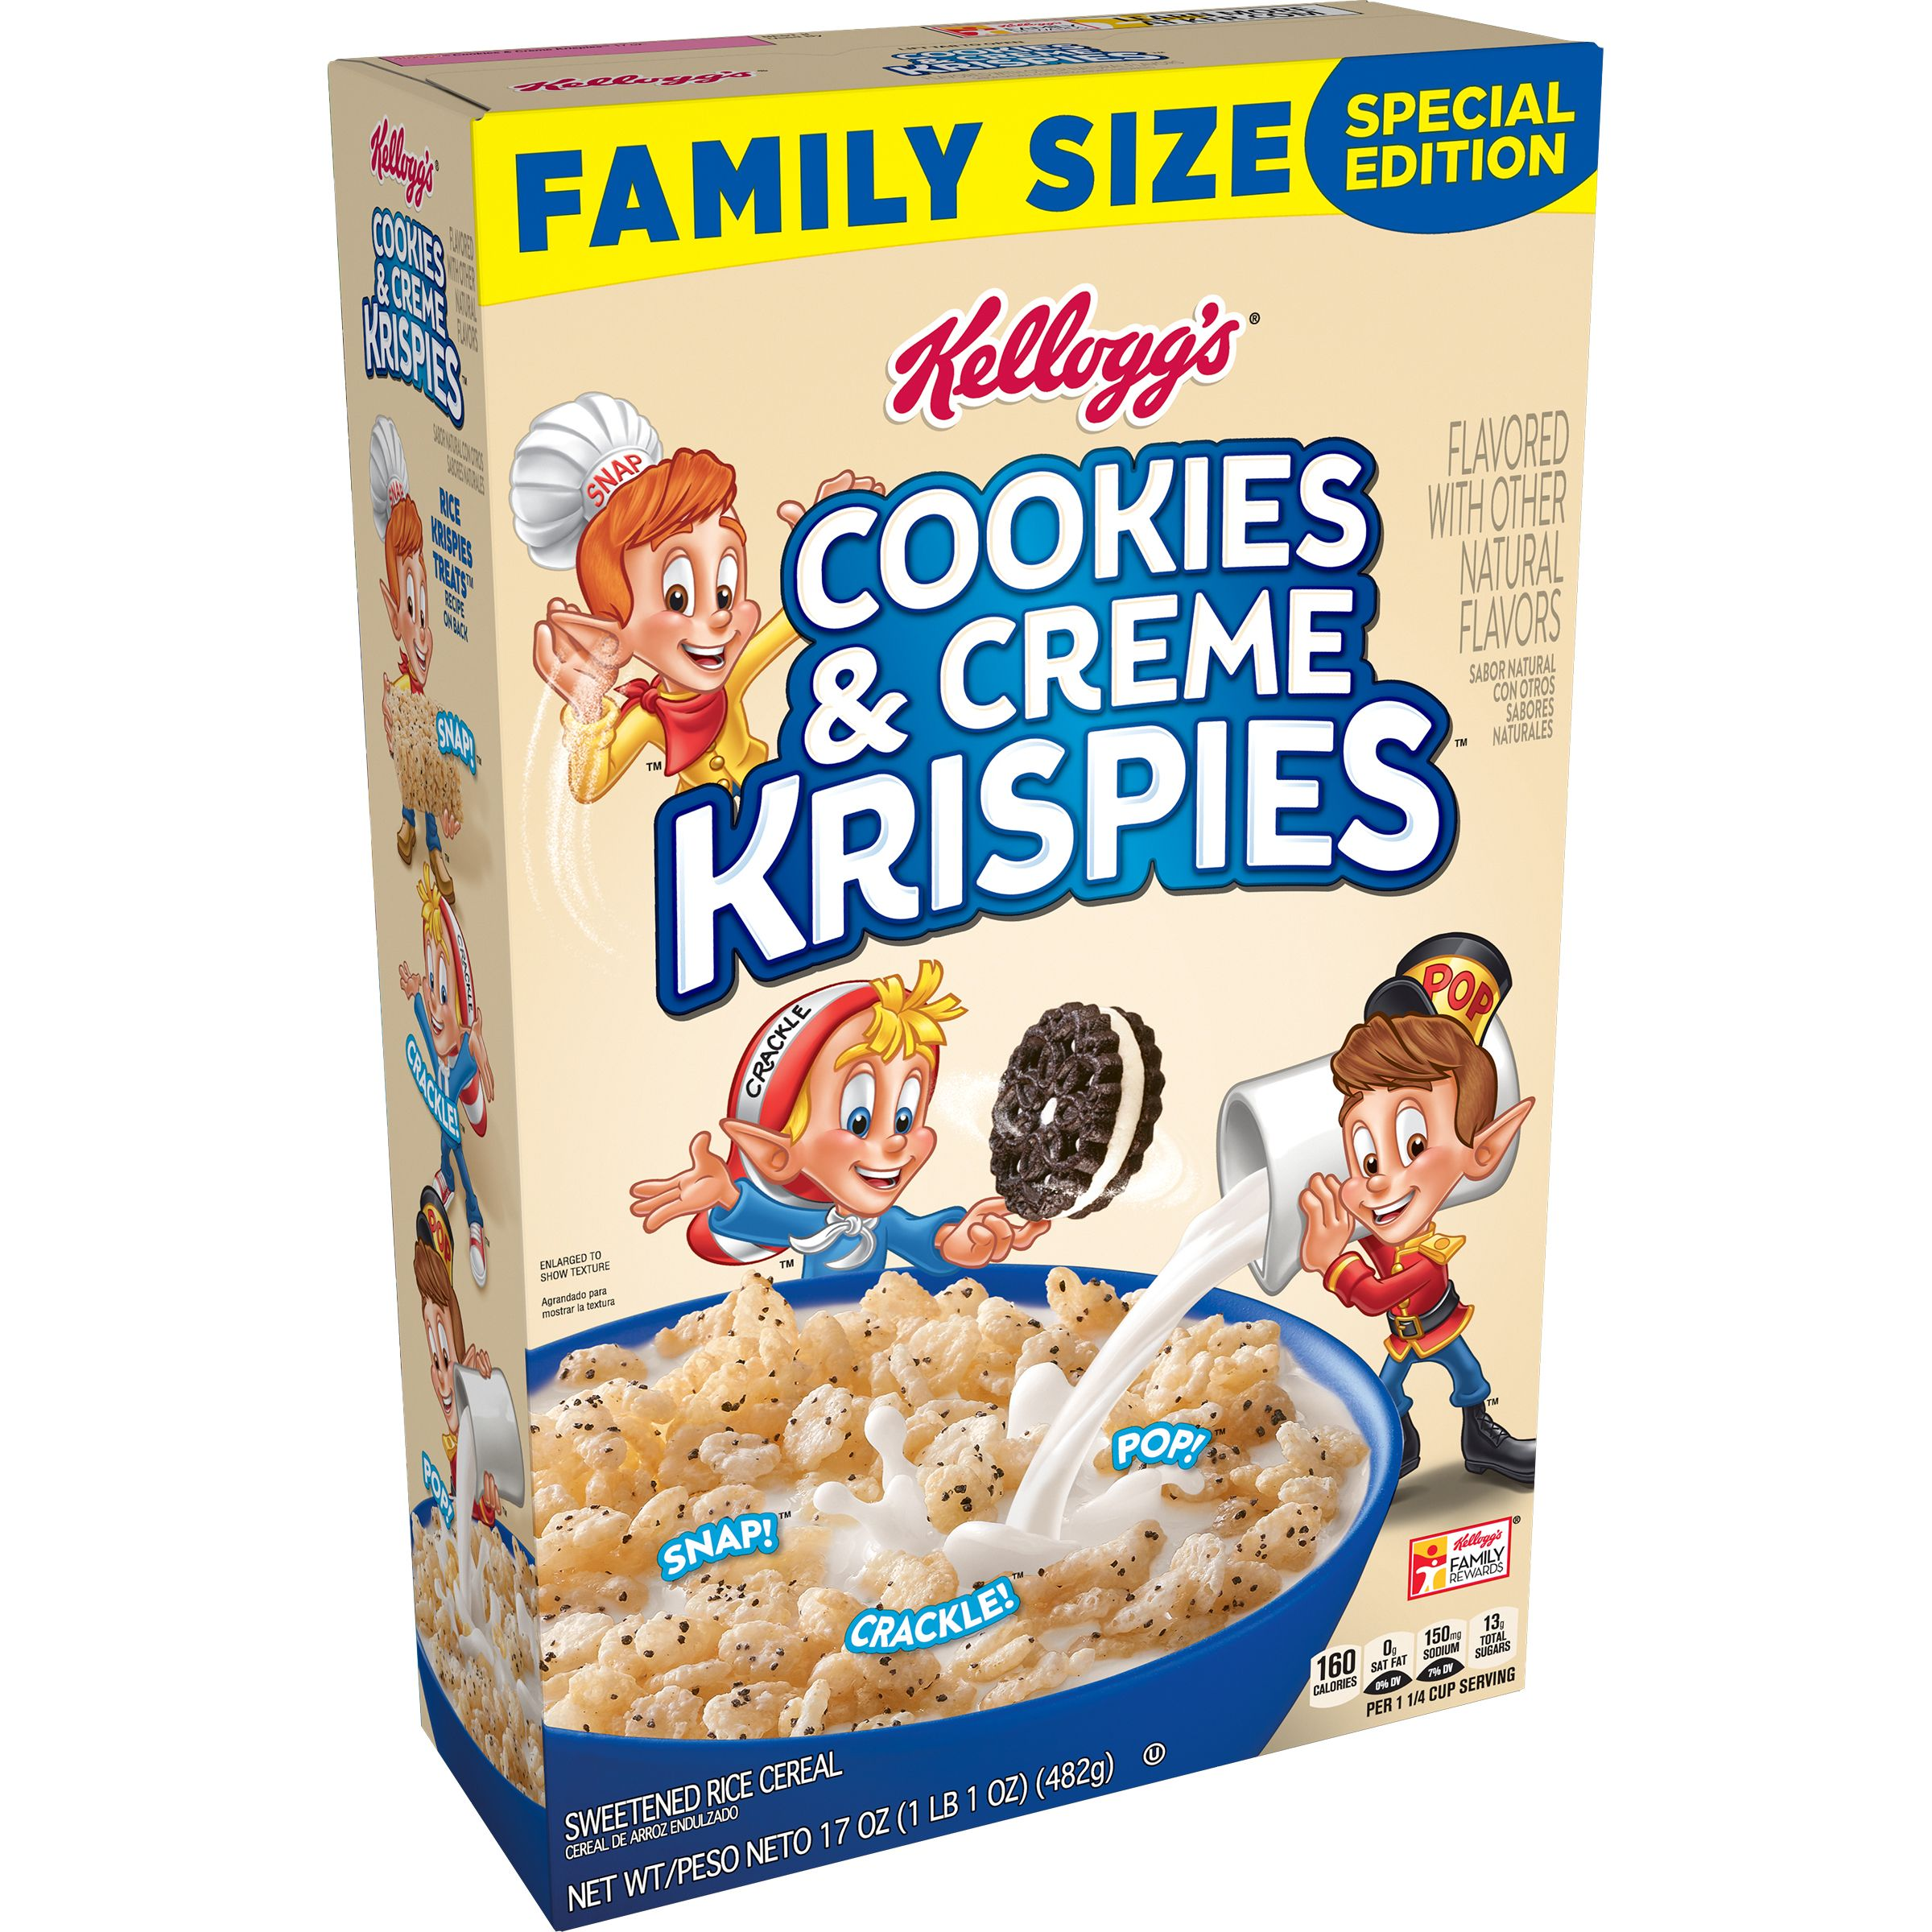
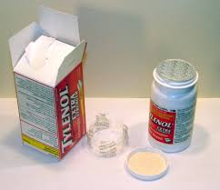
Functions of packaging
Provides a label where information can be conveyed to the customer, e.g. nutritional information.
Helps inform customer, e.g. “New”, “New improved flavour”, “Family size”.
Protect the product so it does not get damaged, contaminated, dirty while shipping or being used.
Prevents tampering, e.g. safety seal that forms part of the packaging.
Makes it easier to use the product, e.g. easier to hold shape of Coke bottle, yogurt & sprinkles packaged in one container
https://hips.hearstapps.com/vader-prod.s3.amazonaws.com/1596814619-8fb2e6a7-018e-4293-91f6-e640fed4a875.696a1a910e3201332d04aef33914a778.jpg
Tamper proof packaging

Slide 38
Innovative packaging
Innovative packing and labelling is important for a number of reasons, e.g. it attracts attention, creates feelings, provide information to the potential customer, and the like. See the earlier slides.
Watch the video below for more examples of packaging and label functions.
NOTE: The term “touchpoint” means anything about the organisation that the customer comes into contact with, e.g. the product, the brand name, the packaging, the service in the business, etc.
https://www.youtube.com/watch?v=gzl-H_wicHk&list=PL-l2OL3NKvvAjmqSbjMfToB4cYPWbEIqg&index=7

Slide 39
Thank you!
https://www.marketing91.com/product-concept/

